Slide 1
Requirement Management
Chapter 3

Slide 2
Topics to be covered…
Functional and Non-functional Requirements
Requirement Elicitation:Interviews,Questionnaire,
Brainstorming, Facilitated Application Specification
Technique
Requirement Analysis Feasibility Study
Types of Feasibility
Software Requirement Specification
Validation

Slide 3
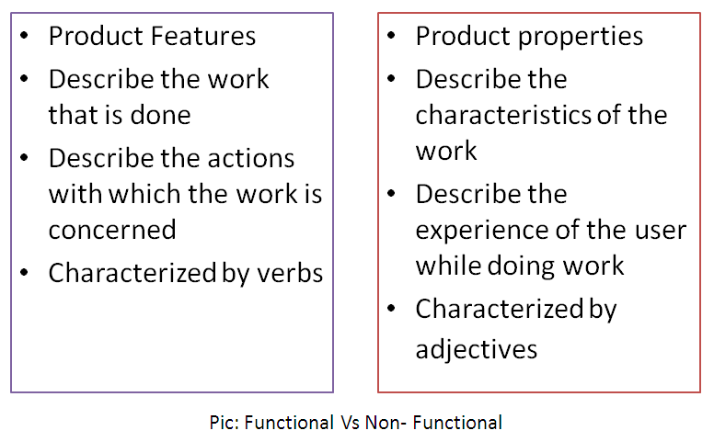
Functional Vs. Non- functional

Slide 4

Feasibility study

Slide 5
What is a Feasibility Study
Is this a good business idea?
Helps answer the question of whether to go forward with the business idea.

Slide 6
What are the users demonstrable needs and how does the system meet them?
What resources are available for given candidate system? Is the problem worth solving?
What are the impacts of the system on the organization?
How well does it fit with in the organizations master MIS plan?

Slide 7
Result of feasibility study is a formal proposal
It is a formal document including the nature and scope of proposed solution
It summarizes
what is known? and what is going to be done?

Slide 8
It consist of the following
Statement of the problem
Summary of findings and recommendation
Details of findings
Recommendations and conclusions

Slide 9
If the study is to serve as a decision document, it must answer the following questions
Is there a new and better way to do the job that will benefit the user?
What are the costs and savings of the alternatives?
What is recommended?

Slide 10
Six common factors
The acronym TELOS refers to the five areas of feasibility –
Technical,
Economic
Legal
Operational
Scheduling.

Slide 11
Technology and system feasibility
Based on an outline design of system requirements
whether the company has the technical expertise to handle completion of the project.
If the budget is a serious constraint then the project is judged not feasible
When writing a feasibility report:
A brief description of the business to assess more possible factor/s which could affect the study
The part of the business being examined
The human and economic factor
The possible solutions to the problems

Slide 12

Legal Feasibility
Determines whether the proposed system conflicts with legal requirements,
Covid – 19 Apps

Slide 13

Operational Feasibility
projects fits in with the existing business environment and
objectives with regard to development schedule,
delivery date,
corporate culture,
and existing business processes

Slide 14

Economic feasibility
It is the most frequently used method for evaluating the effectiveness of a system
It is commonly known as cost/benefit analysis
The benefits and savings that are expected from a system and compare them with costs

Slide 15
If benefits outweigh cost 🡪 decision is made to design and implement system
Else further justification or alteration in the proposed system

Slide 16
Technical feasibility
Question is “Can it be built?”
TF Reviews:
-Technical Capability of HR
-Capability of Available at Technical side
“Choice of Available Technologies for Alternative Design” purposes, considering:
a. Physical layout
b. Engineering design
c. Availability of raw materials?

Slide 17
Technical feasibility
Primary task of TF is Blueprinting:
a) Manpower Needs
b) Resources, and Design
c) Provide Design Alternatives
d) A Choice of Available Technologies,
& Cost estimates for each alternative.

Slide 18
Schedule Feasibility
A project will fail if it takes too long to be completed.
How long the system will take to develop, payback period?
How reasonable the project timetable is.
Are the project deadlines reasonable?
Are deadlines are mandatory or desirable?

Slide 19
Other feasibility factors
Market and real estate feasibility
Resource feasibility
Cultural feasibility
Financial feasibility
Market research study and analysis

Slide 20
Fact finding methods
The method used for collecting data about requirements is called fact-finding techniques
Review existing reports forms and procedure descriptions
Conduct interviews
Observe & document business processes
Build prototypes
Questionnaires
Conduct JAD sessions

Slide 21
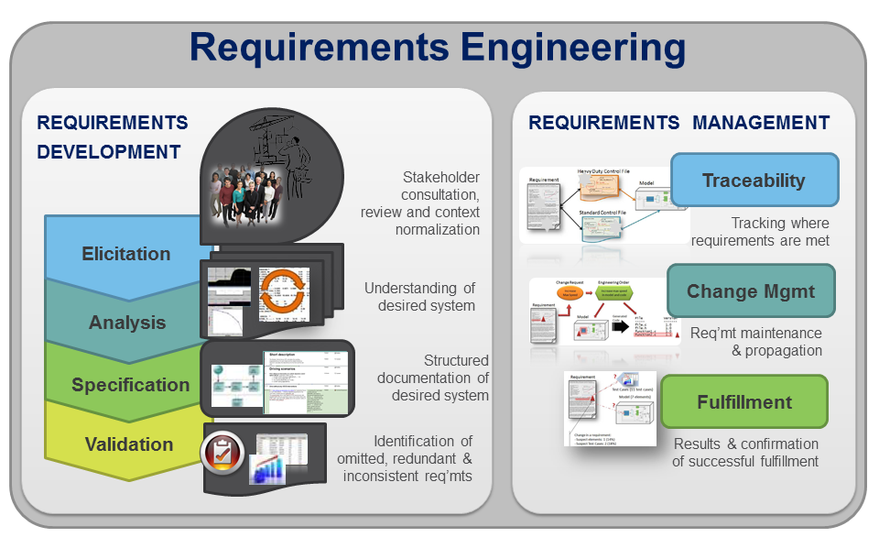

Slide 22
Software Engineering Tasks
Seven distinct tasks
Inception
Elicitation
Elaboration
Negotiation
Specification
Validation
Requirements Management

Slide 23
Inception
Elicitation
Elaboration
Negotiation
Specification
Validation
Requirements
Management
23

Slide 24


Slide 25
Inception Task
During inception, the requirements engineer asks a set of questions to establish…
A basic understanding of the problem
The people who want a solution
The nature of the solution that is desired
Through these questions, the requirements engineer needs to…
Identify the stakeholders
Recognize multiple viewpoints
Work toward collaboration
Break the ice and initiate the communication
25

Slide 26
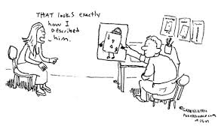
Elicitation

Slide 27
Elicitation Task
Eliciting requirements is difficult because of
Problems of scope in identifying the boundaries of the system
Problems of understanding
Problems of volatility because the requirements change over time
Elicitation may be accomplished through two activities
Collaborative requirements gathering
Quality function deployment
27

Slide 28
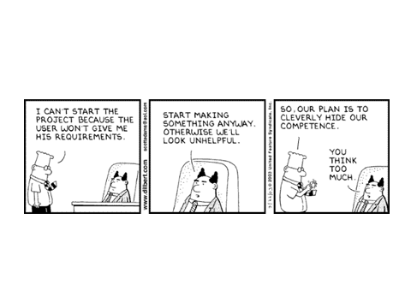
Requirement Elicitation Techniques

Slide 29
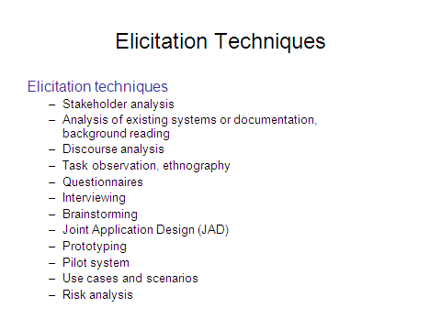

Slide 30

1. Conduct Interviews and Discussions with Users

Slide 31
2. Conduct Interviews and Discussions with Users
Effective way to understand business functions and rules
Time-consuming and resource-expensive
May require multiple sessions to:
Meet all users
Understand all processing requirements
Can meet with individuals or groups of users
List of detailed questions prepared

Slide 32
Structured interviews
Similar questions in a predetermined format to all candidates.
Emphasis tends to be on your past experience and assets you can bring to company.

Slide 33
Unstructured interviews
Much more casual and unrehearsed.
Questions about skills and strengths can be asked and should be answered as formally.

Slide 34
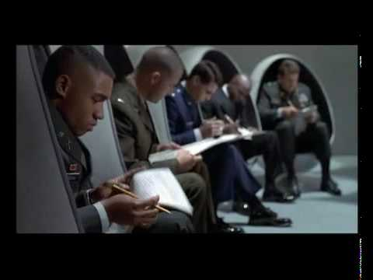
2. Questionnaire

Slide 35
2. Questionnaire
It allows analyst to collect information about various aspects of a system from a large number of persons
Use of standardized question format can yield more data
It does not allow analyst to observe the expressions of respondent

Slide 36
A QUESTIONNAIRE IS ONLY AS GOOD AS THE QUESTIONS IT ASKS
Notes:
36

Slide 37
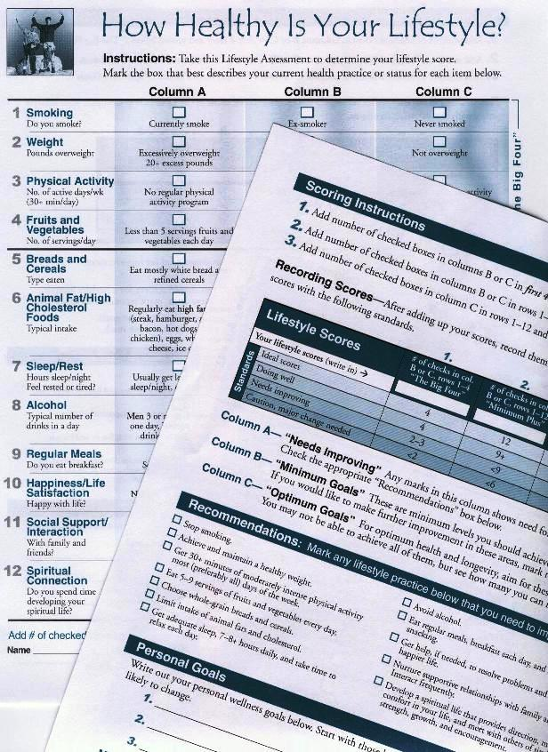
What is a Questionnaire?
A set of Questions designed to generate the statistical information from a specific demographic need to accomplish the research objectives
Notes:
37

Slide 38
Surveys are more than a collection of unambiguous questions
How questions are specified and put together will influence the respondents’ willingness to participate & the responses they provide
Notes:
38

Slide 39
The Major Decisions in Questionnaire Design
1. Content - What should be asked?
2. Wording - How should each question be phrased?
3. Sequence - In what order should the questions be presented?
4. Layout - What layout will best serve the research objectives?
The most difficult step is specifying exactly what information is to be collected from each respondent
Notes:
39

Slide 40
Content
How requirement questions.
Where requirement questions.
When requirement questions.
Who requirement questions.
What requirement questions.
Why requirement questions.

Slide 41
How Requirement Questions
How will you use this feature?
Is this feature a process and, if so, what are the steps? Or, what questions can I ask to ascertain the steps?
How might we achieve in this business need?
How might we think about this feature a bit differently?
How will we know this is complete?

Slide 42
Where requirement questions.
Where does the process start?
Where would the user access this feature?
Where would the user be located physically when using this feature?
Where would be the results be visible?

Slide 43
When requirement questions.
When will this feature be used?
When do you need to know about…?
When will the feature fail?
When will we be ready to start?

Slide 44
Who requirement questions.
Who will use this feature?
Who will deliver the inputs for the feature?
Who will receive the outputs of the feature?
Who will learn about the results of someone using this feature?
Who can I ask to learn more about this?

Slide 45
What requirement questions.
What do I know about this feature?
Or, what assumptions am I making about this feature that I need to confirm?
What does this feature need to do?
What is the end result of doing this?
What are the pieces of this feature?
What needs to happen next?
What must happen before?
What if….? Think of all the alternative scenarios and ask questions about what should happen if those scenarios are true.
What needs to be tracked?

Slide 46
Why requirement questions.
Why questions are great wrap-up questions as they help confirm that the requirements you just elicited map back to a need you identified when you scoped the project.
Is there any other way to accomplish this?
Does this feature meet the business need and solve the problem we’re trying to solve?

Slide 47
Advantages of questionnaire
It is economical
It can be administered to a large number of individuals simultaneously
Respondents feel greater confidence
It places less pressure on subjects for immediate responses

Slide 48
Disadvantages of questionnaire
Low percentage of returns
Many people have difficulty expressing themselves in writing
3. Many dislike writing
so interview is superior to questionnaire

Slide 49
Two types of questionnaire are there
1. Open-ended questionnaire
2. Closed-ended questionnaire

Slide 50
Open-ended questionnaire
It requires no response direction or specific response
They are used to learn about feelings, opinions, and general experiences
It is used to explore a process or problem
Main drawback is the difficulty of interpreting subjective answers and tedious responses

Slide 51
Closed-ended questionnaire
In this responses are presented as a set of alternatives
It is appropriate for securing factual information
They are quick to analyze
There are five major varieties of closed questions

Slide 52
Fill-in-the blanks
Dichotomous
Priority/Rank based questions
Multiple choice questions
Rating scale questions

Slide 53
Brainstorming Sessions:
It is a group technique
It is intended to generate lots of new ideas hence providing a platform to share views
A highly trained facilitator is required to handle group bias and group conflicts.
Every idea is documented so that everyone can see it.
Finally, a document is prepared which consists of the list of requirements and their priority if possible.

Slide 54
FAST
Facilitated Application Specification Technique: It’s objective is to bridge the expectation gap – difference between what the developers think they are supposed to build and what customers think they are going to get.
A team oriented approach is developed for requirements gathering. Each attendee is asked to make a list of objects that are-
Part of the environment that surrounds the system
Produced by the system
Used by the system
Each participant prepares his/her list, different lists are then combined, redundant entries are eliminated, team is divided into smaller sub-teams to develop mini-specifications and finally a draft of specifications is written down using all the inputs from the meeting.

Slide 55
Software Requirements Specification
SRS is a complete description of the behavior of a system to be developed and may include a set of use cases that describe interactions the users will have with the software.
Also contains non-functional requirements
This is prepared after detailed communications with the project team and customer.
The SRS may be one of a contract deliverabledeliverable Data Item Descriptions or have other form of organizationally-mandated content.

Slide 56
Software requirements: functional and non- functional domain
A functional requirement describes
what a software system should do?
while non-functional requirements place constraints on
how the system will do so.

Slide 57
An example of a functional requirement would be that a system must send a an email whenever a certain condition is met (e.g. an order is placed, a customer signs up, etc).
A related non-functional requirement for the system may be that emails should be sent with a latency of no greater than 12 hours from such an activity.

Slide 58
Examples of Functional Requirements
Interface requirements
Field accepts numeric data entry
Field only accepts dates before the current date
Screen can print on-screen data to the printer
read data with electronic signatures

Slide 59
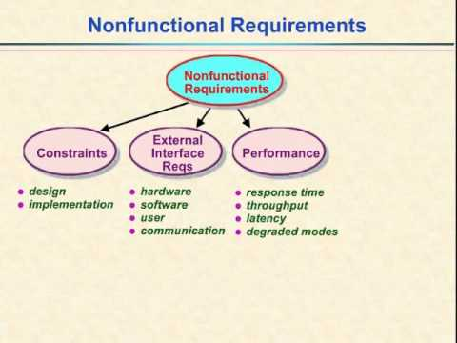

Slide 60
Typically non-functional requirements fall into areas :
Accessibility
Capacity, current and forecast
Compliance
Documentation
Disaster recovery
Efficiency
Effectiveness
Extensibility
Fault tolerance
Interoperability
Maintainability
Privacy
Portability
Quality
Reliability
Resilience
Response time
Robustness
Scalability
Security
Stability
Supportability
Testability

Slide 61
SRS Template
Introduction
Purpose
Definitions
System overview
References
Overall description
Product perspective
System Interfaces
User Interfaces
Hardware interfaces
Software interfaces
Communication Interfaces
Memory Constraints
Operations
Site Adaptation Requirements

Slide 62
Product functions
User characteristics
Constraints, assumptions and dependencies
Specific requirements
External interface requirements
Functional requirements
Performance requirements
Design constraints
Standards Compliance
Logical database requirement
Software System attributes
Reliability
Availability
Security
Maintainability
Portability
Other requirements

Slide 63
Requirement Validation Task
Checklists ensure that no source of errors, whether major or minor, is overlooked by the reviewers. A ‘good’ checklist consists of the following.
Is the initial state of the system defined?
Is there a conflict between one requirement and the other?
Are all requirements specified at the appropriate level of abstraction?
Is the requirement necessary or does it represent an add-on feature that may not be essentially implemented?
Is the requirement bounded and has a clear defined meaning?
Is each requirement feasible in the technical environment where the product or system is to be used?
Is testing possible once the requirement is implemented?
Are requirements associated with performance, behavior, and operational characteristics clearly stated?
Are the requirements consistent with the overall objective specified for the system/product?
Have all hardware resources been defined?
Is the provision for possible future modifications specified?
Are functions included as desired by the user (and stakeholder)?
Can the requirements be implemented in the available budget and technology?
Are the resources of requirements or any system model (created) stated clearly?
63

Slide 64
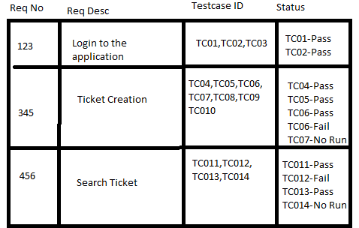
Requirement Management

Slide 65
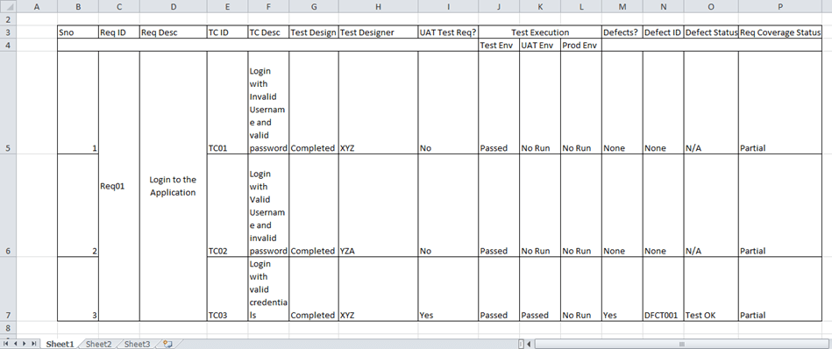
Requirement Management

Slide 66
Requirement Validation Task
Test case generation: The requirements specified in the SRS document should be testable. The test in the validation process can reveal problems in the requirement. In some cases test becomes difficult to design, which implies that the requirement is difficult to implement and requires improvement.
Automated consistency analysis: If the requirements are expressed in the form of structured or formal notations, then CASE tools can be used to check the consistency of the system. A requirements databaseIf the requirements are expressed in the form of structured or formal notations, then CASE tools can be used to check the consistency of the system. A requirements database is created using a CASE tool that checks the entire requirements in the database using rules of method or notation. The report of all inconsistencies is identified and managed.
Prototyping: Prototyping is normally used for validating and eliciting new requirements of the system. This helps to interpret assumptions and provide an appropriate feedback about the requirements to the user. For example, if users have approved a prototype, which consists of graphical user interface, then the user interface can be considered validated.
66

